Slide 1

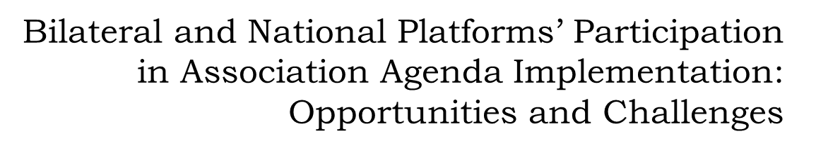

Slide 2
Association Agenda is about change
Change as the goal
Change as a prerequisite of change
What about us ?
Shouldn’t we also change to be able to implement our role at the new stage?

Slide 3
EU-Ukraine Civil Society Platform
Establishment - a year of negotiations
CSO activists
representatives of trade-unions and employers
European Economic and Social Committee
the success – the CSP officially created on April 16, 2005
but the compromise is far from initial CSO vision:
low ambitions (2 meetings with 1-2 position papers per year)
institutional challenges – the need to seek consensus between sectors
the solution: the Ukrainian side of the CSP should go further
monitoring of the Association Agreement implementation
activities within thematic working groups

Slide 4

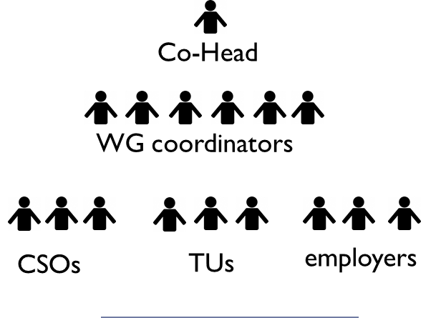



EU-Ukraine Civil Society Platform
Co-Head
Members from EESC
Observers – other EU organizations

Slide 5
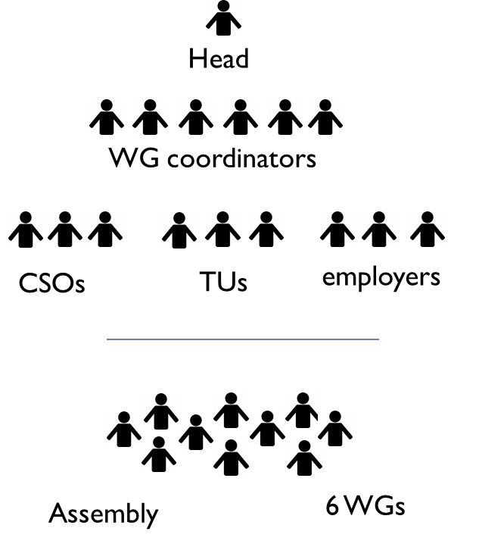



UA Side of CSP EaP CSF UNP
National Facilitator
WG coordinators
Platform
5 WGs

Slide 6
Expectations regarding Platforms’ Participation
Extensive expertise in EU policies and Association Agenda tasks
Effective management
High-quality policy analysis
Capacity to engage in stakeholder dialogue
Effective advocacy campaigns
Financial resources to ensure the above
Active involvement of all members

Slide 7
Reality
A few organizations with strong expertise in each sector but on average lack of knowledge
Particular lack of expertise in economic and trade issues
“Volunteer” management
Products: several statements and position papers per year + a few joint projects/activities
Voicing concerns but not advocating alternatives
Practically no cooperation with other stakeholders
Resources only for statutory activities (at best)

Slide 8
What is necessary to ensure the change
Capacity building (enhancing expertise and skills)
Scrutiny/database of civil society expertise
Professional full-time management + performance standards
Focus on reforms’ MoE and advocacy (full cycle)
Developing signature products (like EaP EI Index)
Together with the Government, initiating stakeholder dialogue
Outreach to wider society (awareness campaigns)
Cooperation with media
Active fundraising
Commitments and reporting from all members

