Slide 1

Eastern Partnership Civil Society Forum Re-Granting 2016
Working Group 4 Meeting 15-16 June
Lauren Foster Mustardé
Programme Development Adviser

Slide 2


Presentation Outline
Provide a summary of our newly funded grant
Provide an introduction to grant lead organisation, HealthProm
Answer any questions
Notes:
Before I begin, I would like to thank you for inviting me here today and more importantly for selecting our project for funding. We are extremely grateful.

Slide 3
The Grant
Communities, Classrooms & Civil Society: Sharing Experience & Developing Regional Approaches to Addressing the Rights and Needs of Children with Disabilities in Belarus, Moldova and Ukraine
HealthProm, UK (lead)
Belarusian Children’s Hospice, Belarus
Partnerships for Every Child, Moldova
Early Intervention Institute (Kharkiv), Ukraine
Grant amount: € 24,681
Notes:
Why this title? Because disability- particularly for children-- transcends all of these domains, From community-based health services to inclusive education opportunities to civil society led advocacy. It is addressed by multiple sectors including education, health and social services.
We have established working relationships with the local partners, who are each leaders in their own fields.

Slide 4
Grant Objectives
Overall objective: to galvanise regional commitment to addressing the rights and needs of children with disabilities and to facilitate the development of regional approaches to this end.
Mechanisms:
Sharing multi-sectoral experience, skills and innovations from each country;
Developing strategies to address shared challenges where possible.
Notes:
Commitment to this area already exists in these countries. They are already doing some very inspiring work in challenging contexts, with varying degrees of government backing.
Our programmes and projects support…

Slide 5
Target Groups
Civil society organisations (disability and parent led)
Health, education and social care professionals
Local and national authorities
Final beneficiaries:
Children with disabilities and their families

Slide 6
HealthProm
Notes:
Before I go further, I want to introduce you to our organisation, the lead partner, and tell you about what we do.
Our programmes and projects support…

Slide 7
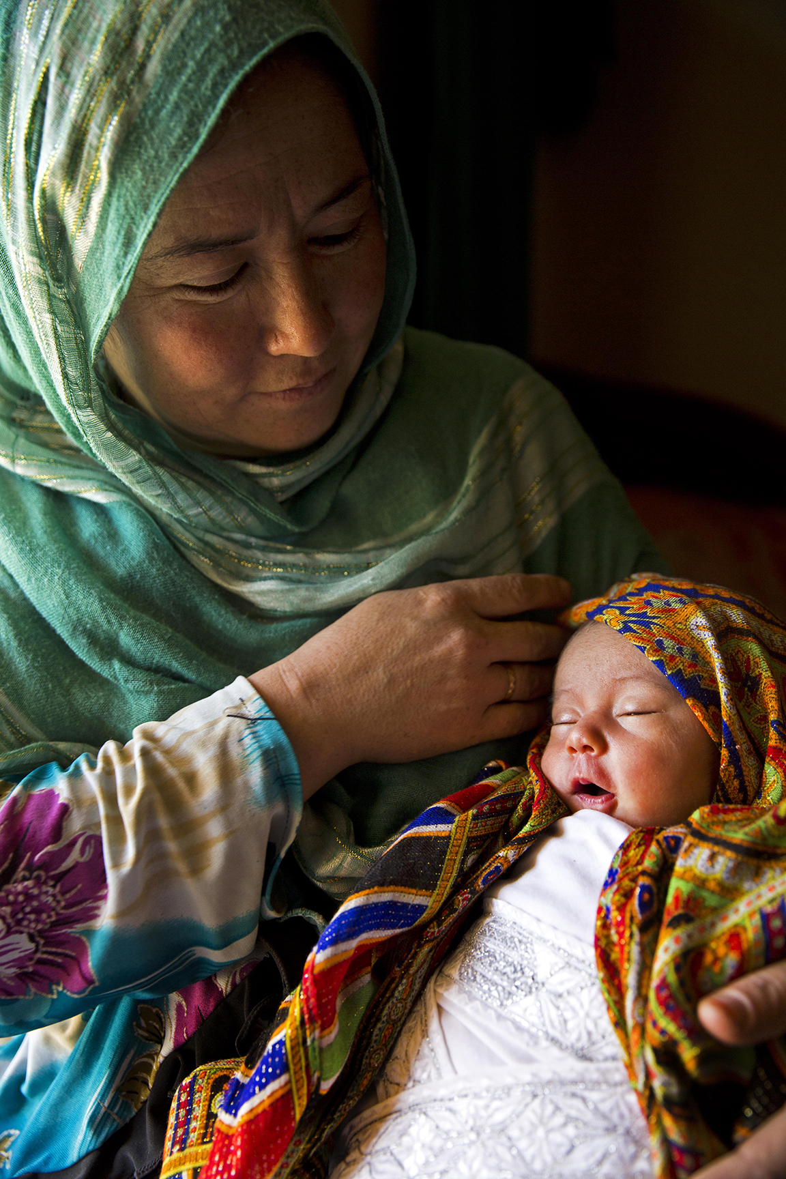
Who are we?
We are a small international NGO based in London, working to support vulnerable children, women and families in Eastern Europe, Central Asia and the former Soviet Union.
Our work addresses 3 key challenges:
Poor maternal and child health;
High levels of institutionalisation of young children;
Social exclusion of children with disabilities.

Slide 8
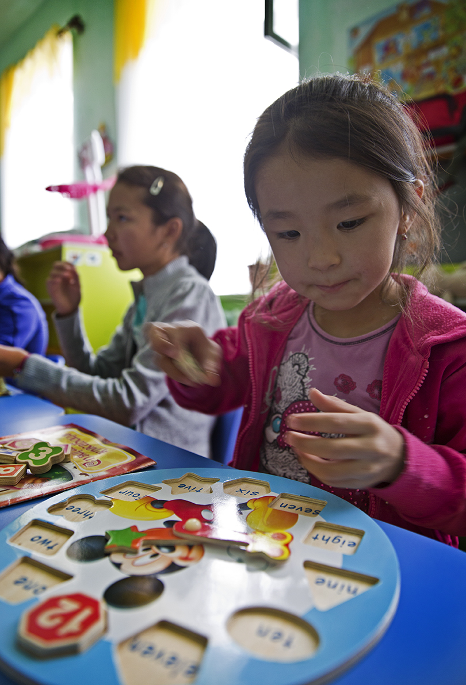
Our Countries
Afghanistan
Belarus
Kyrgyzstan
Moldova
Russia
Tajikistan
Ukraine

Slide 9
What do we do?
Our mission is to work together with local partners to promote health and social care for vulnerable children and their families. Our work is guided by building local capacity, evidence-based practice and working through partnership.
We support…
Health and social services to improve maternal and child health and better support vulnerable families;
Schools to improve inclusive education opportunities for children with disabilities;
Civil society organisations and community groups to prevent child abandonment and promote grassroots advocacy for vulnerable children; and
Governments in their efforts towards de-institutionalisation of care and inclusive education.

Slide 10
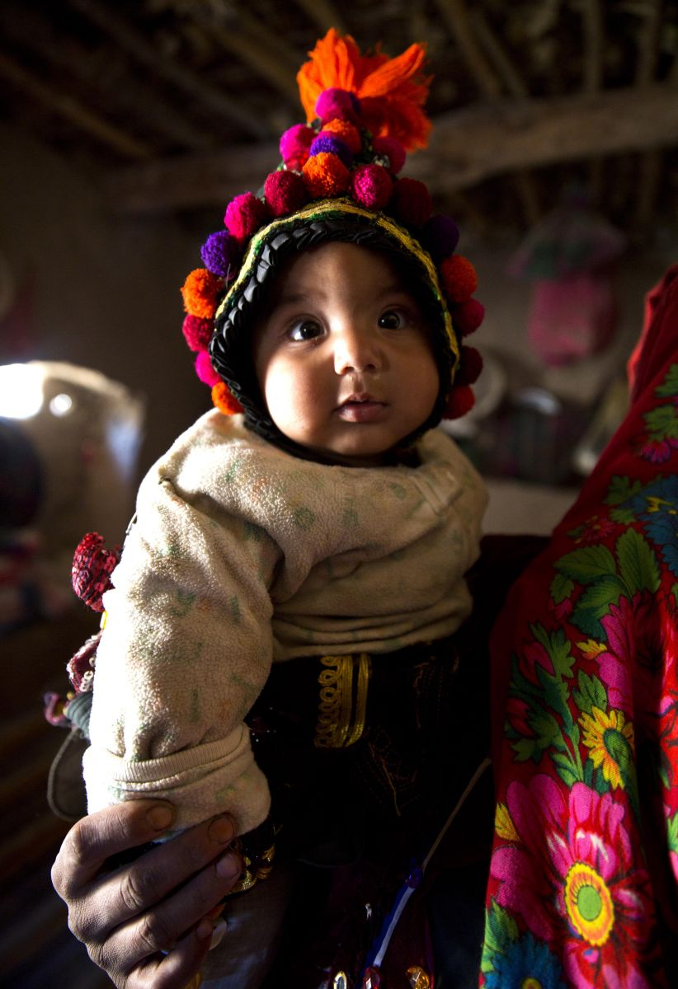
Our Projects
Reducing maternal and neonatal mortality in rural Afghanistan
Siberian Initiative for Inclusion – building local partnerships for inclusion of children with disabilities in Siberia
Strengthening the capacity of civil society organisations to support the delivery of reforms that address the rights and needs of young children with disabilities in Ukraine.
Notes:
Some examples of our projects

Slide 11
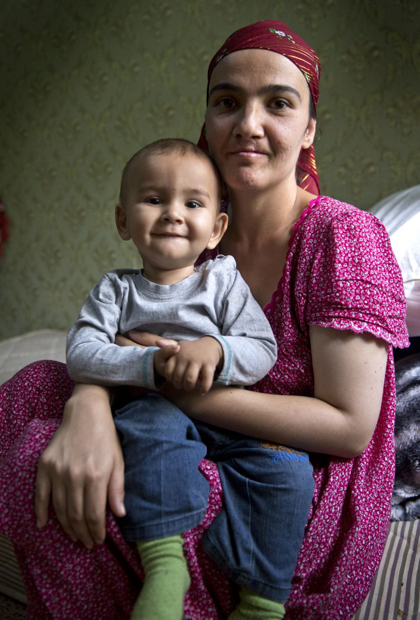
Our Projects
Improving access to preschool support services for vulnerable children with special needs in Moldova
Putting families first: safe, sustainable families in urban and rural communities in Tajikistan
Developing a pilot advocacy service in Belarus to protect the rights of children with severe disabilities and children with life-limiting conditions.
Notes:
We have established working relationships with our local partners, and are already working with them on larger EC funded grants.

Slide 12



Our Major Donors
Notes:
And Eastern Partnership CSF Secretariat!

Slide 13
Grant Activities
Background research (June – July):
Mapping exercise, policy analysis of each country for comparison.
Review of key initiatives and trends at the EU level, with a focus on the UK
Production of a report
Regional Forum Event (September/October):
Hosting a regional event in Kyiv with professionals from each country focusing on challenges, innovations and shared strategy.
Production of a report and recommendations
Facilitation of an online professional network
Notes:
Back to our new grant funded by the Eastern Partnership…
Professional participants will include representatives from civil society, education & health sectors and local government in each country.
Particular focus during the event will be on communications- and the importance of evidence-based communication strategies about disability and its impact on advocacy, the media, public, and engaging parents of CWDs.
Our programmes and projects support…

Slide 14
What has been done already?
Partner MoUs drafted and signed;
Financial admin procedures initiated by HealthProm;
Work plan circulated and discussed with partners;
Protocol for Phase 1 (Background Research) developed;
Questionnaire developed and circulated to partners;
Plan developed for EU and UK background research;
Location of Regional Forum Event selected.

Slide 15

Questions?

Slide 16
THANK YOU
lauren@healthprom.org
www.healthprom.org
facebook.com/HealthProm · twitter: @healthprom
Registered charity number: 1100459

